Slide 1


Cryptfalcon auto trader
Andrew Martin

Slide 2

What is CryptFalcon?
Automated Cryptocurrency Manager
Analyzes Market Trends
Creates Buy and Sell Orders
Graphical Interface
Automated and Manual Transactions Supported

Slide 3

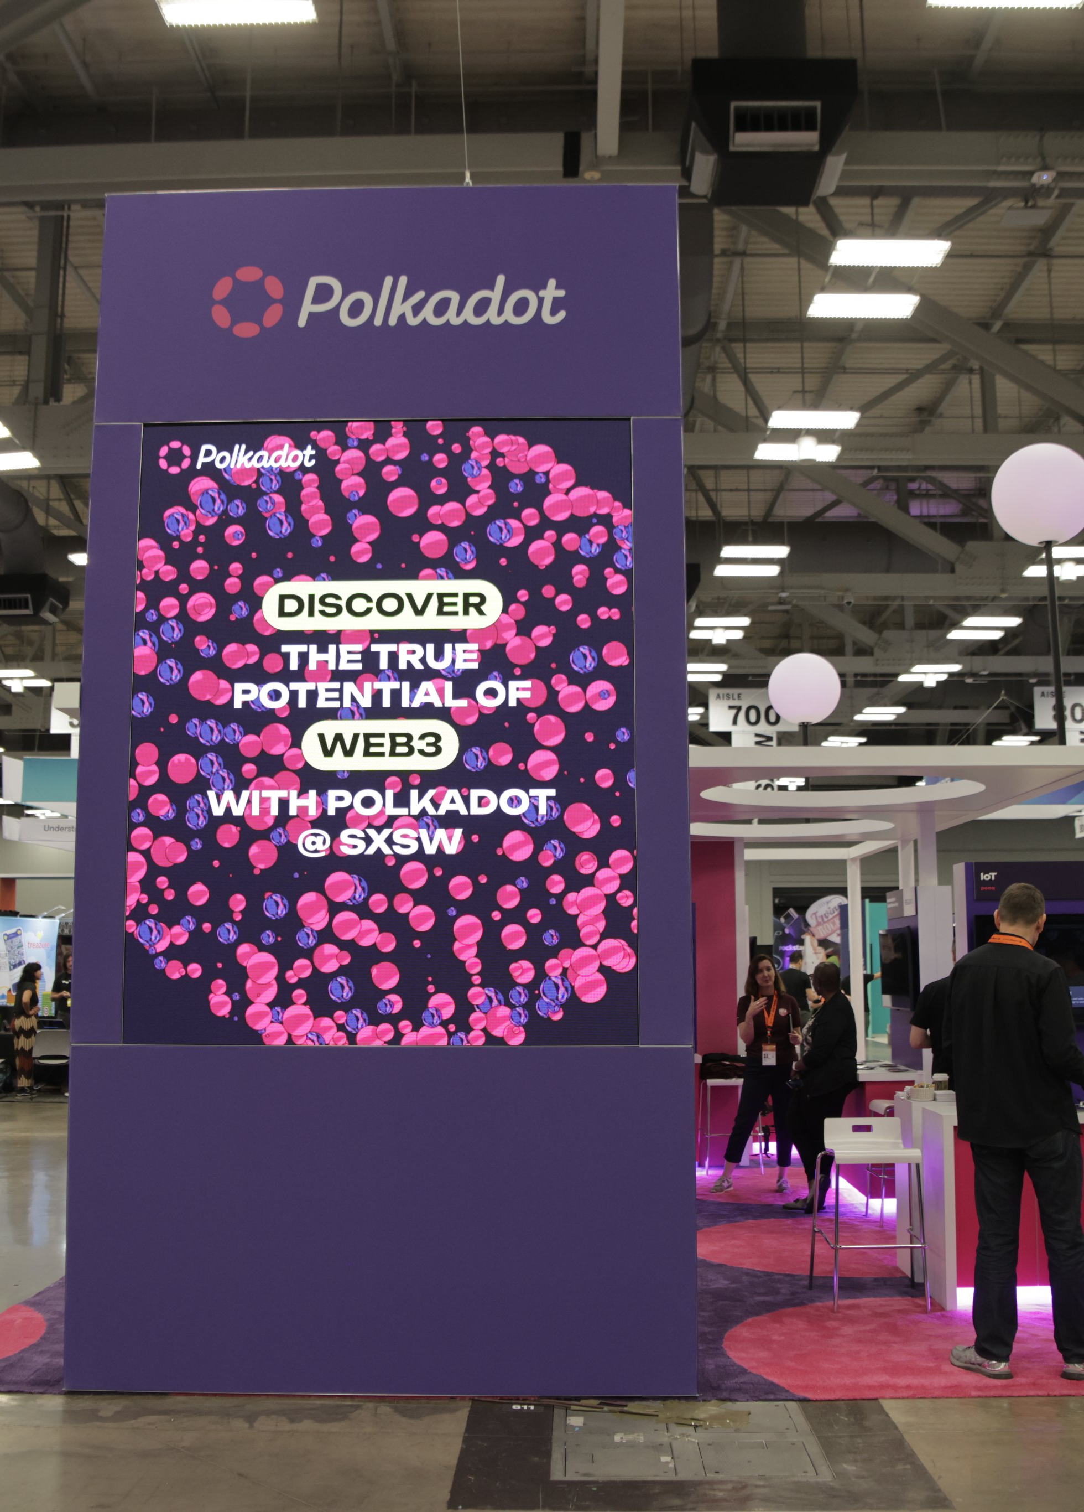
Inspiration
Started Trading Cryptocurrencies in High School for Fun
Got Serious About Crypto and Blockchain Last Summer
Started Research and Work on CryptFalcon Last Semester
First Iteration Completed Winter Break
SXSW Polkadot Booth
Watr – Commodities On-chain
Nodle – Decentralized IOT
https://twitter.com/Polkadot/status/1635019453112156161/photo/3

Slide 4

Learning Process
Investment Strategies
Linear Analysis with Hard Limits → MACD Strategy Using Moving Averages
Python Modules
Pandas Data Analysis
Binance API
MultiProcessing
Graphical Interface Using Tkinter

Slide 5

DEMO

Slide 6
Future Improvements

Slide 7
THANK YOU!

